Slide 1

PRESENTATION
ON
THEFT REPORTING SYSTEM
Presented By
MD KHUSHBU REZA 170319
SAGUN GIRI 170339
SANDIP PATEL 170340
Under the Supervision of
Ms. Astha Sharma
Presented to
The Department of IT and Computer Engineering
In Partial fulfillment of requirement for the degree of
Bachelor of Engineering in Computer Engineering
Cosmos College of Management &Technology
(Affiliated to Pokhara University)
Tutepani, Lalitpur, Nepal

Slide 2
INTRODUCTION
This project “Theft Reporting System”, a web based application.
This application works online where public and police department can use to get effective service compared to the existing manual systems.
It is accessible to the public who wants to log a complaint through the system so it can be very useful for police station .

Slide 3
OBJECTIVES
To provide online platform to register the complaints by the local people regarding crime in their localities.
To help to visualize update of complaints.

Slide 4
FEATURES
Register complaints.
View list of complaints with provided reported by user.
View complaints status.
Generate report to be viewed by the incharge and headquarter.
Helps to narrow down the area where frequents crimes have occurred.

Slide 5
PROBLEM STATEMENT
In the scenario of Nepal unemployment rate is very high. Research and theory addressing the connection between unemployment and theft consistently predict that higher rates of unemployment lead to higher rates of theft.
Mostly in populated urban area the theft are increasing day by day which leads to insecurity of property of the citizens.

Slide 6
LITERATURE REVIEW
Existing System
Hamro Poilce
Hamro Police is smart phone app that enables members of the public within Kathmandu Valley.
Residents and visitors to Kathmandu can report with pictorial and documentary evidence.

Slide 7
COMPARATIVE ANALYSIS
Since our system is fully computerized, it can store more data than paper-based system of Theft management. Similarly, data is easily accessible and collecting past data also can be shown .

Slide 8
SOFTWARE REQUIREMENT
Visual Studio
Apache
php
My SQL
HARDWARE REQUIREMENT
A personal computer or laptop

Slide 9
SYSTEM DEVELOPMENT MODEL

Slide 10
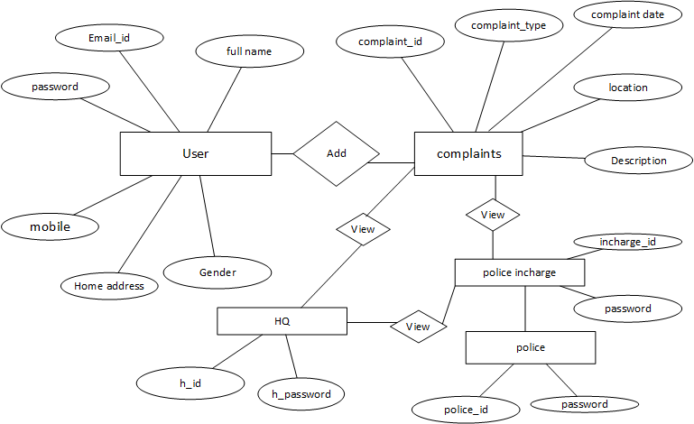
E-R Diagram

Slide 11
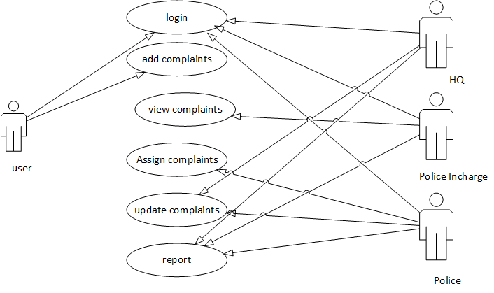
Use-Case Diagram

Slide 12
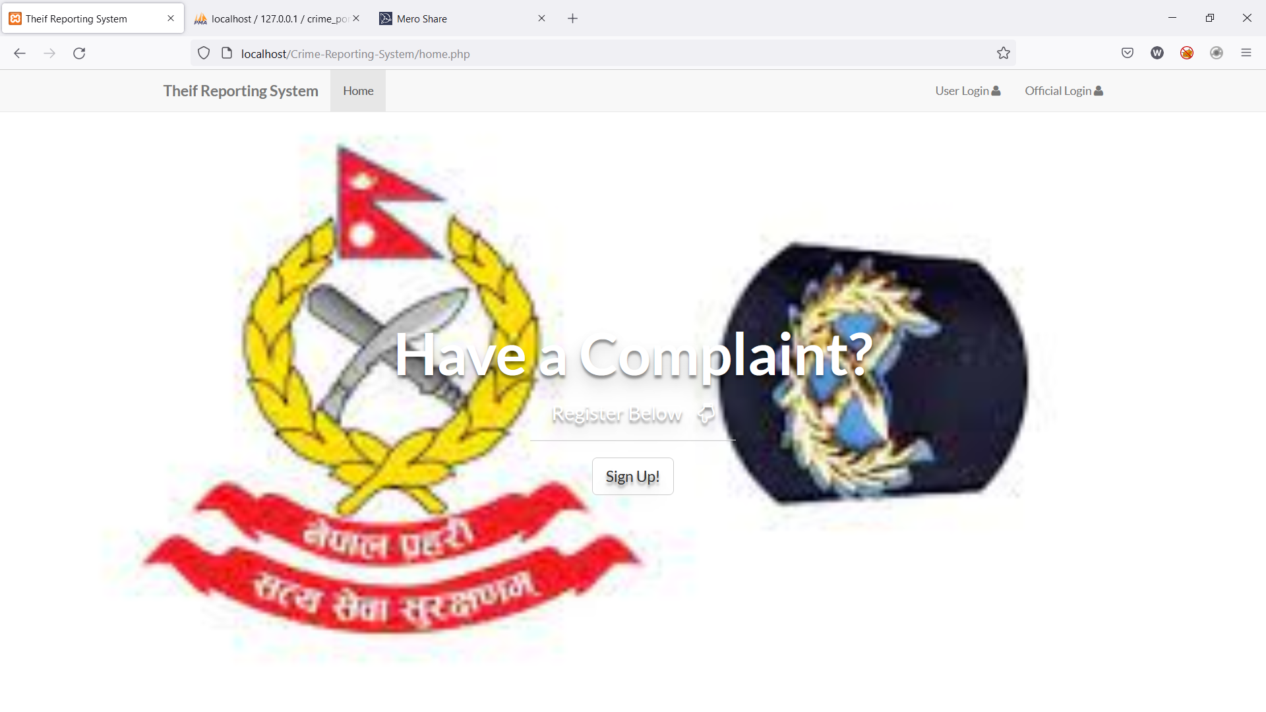
RESULT AND SNAPSHOTS

Slide 13
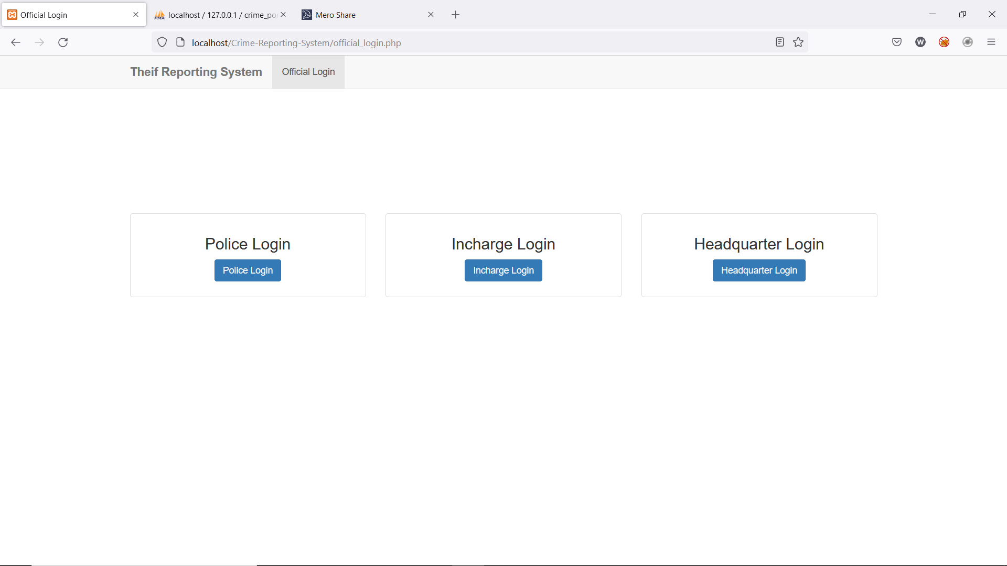
Login/Signup

Slide 14
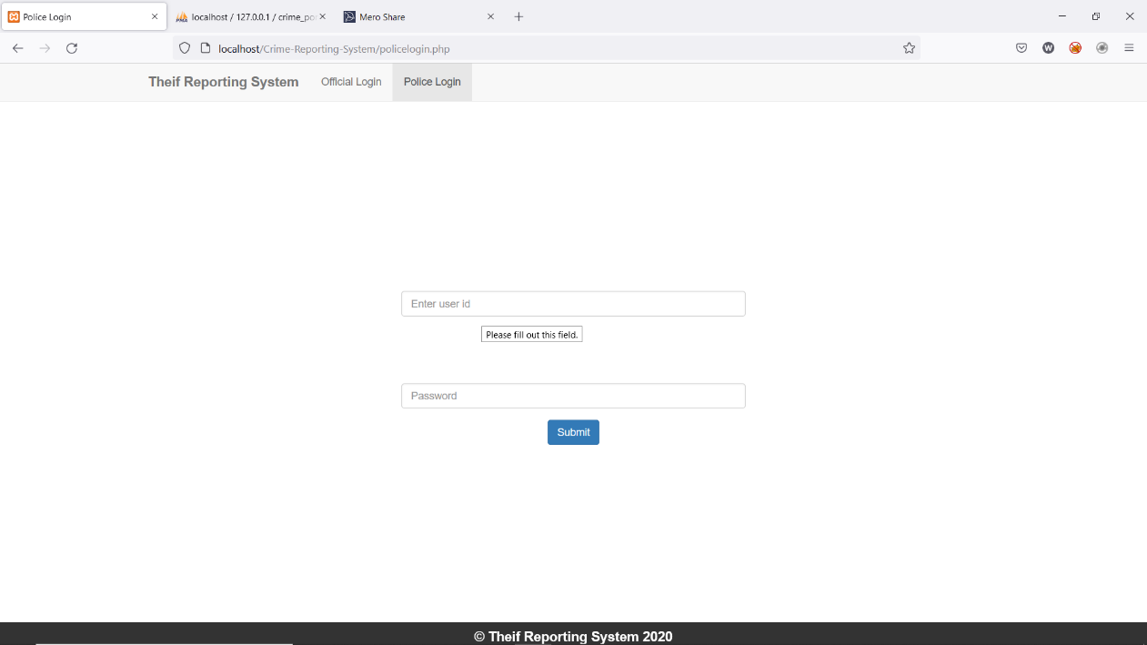
Police login

Slide 15
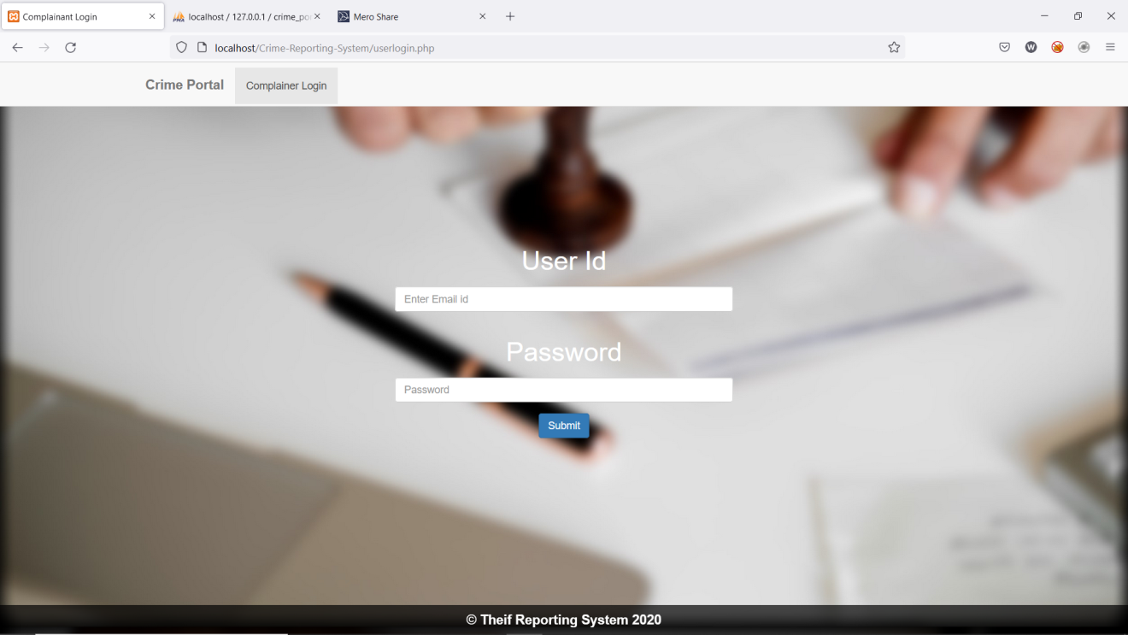
Complainer login

Slide 16
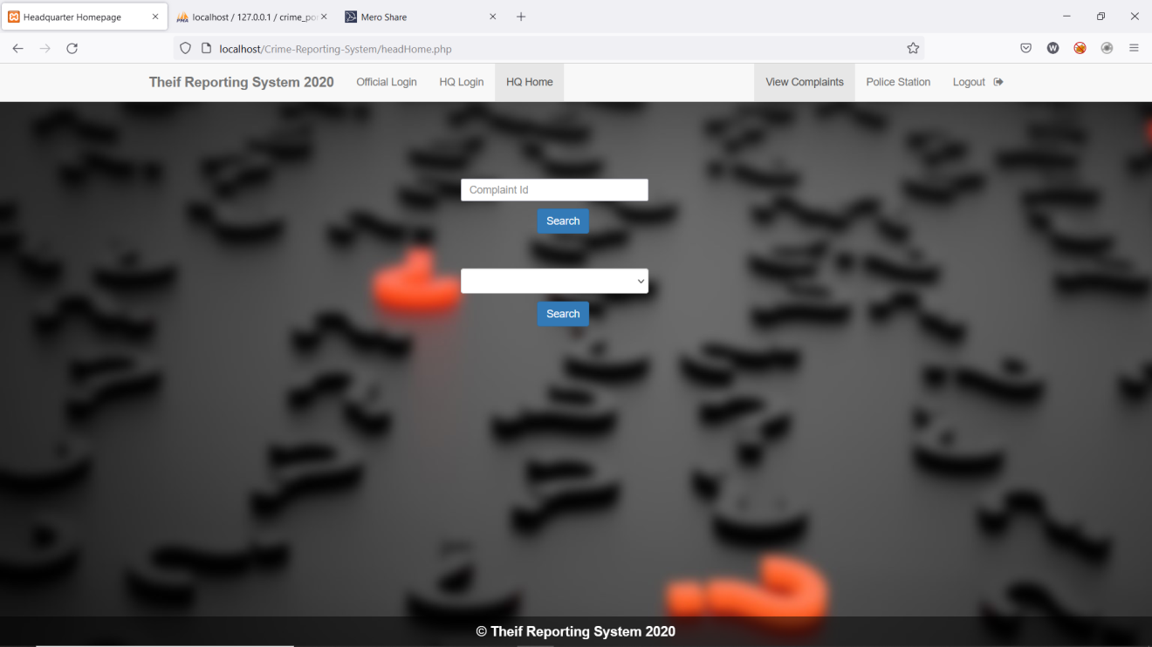
Homepage

Slide 17
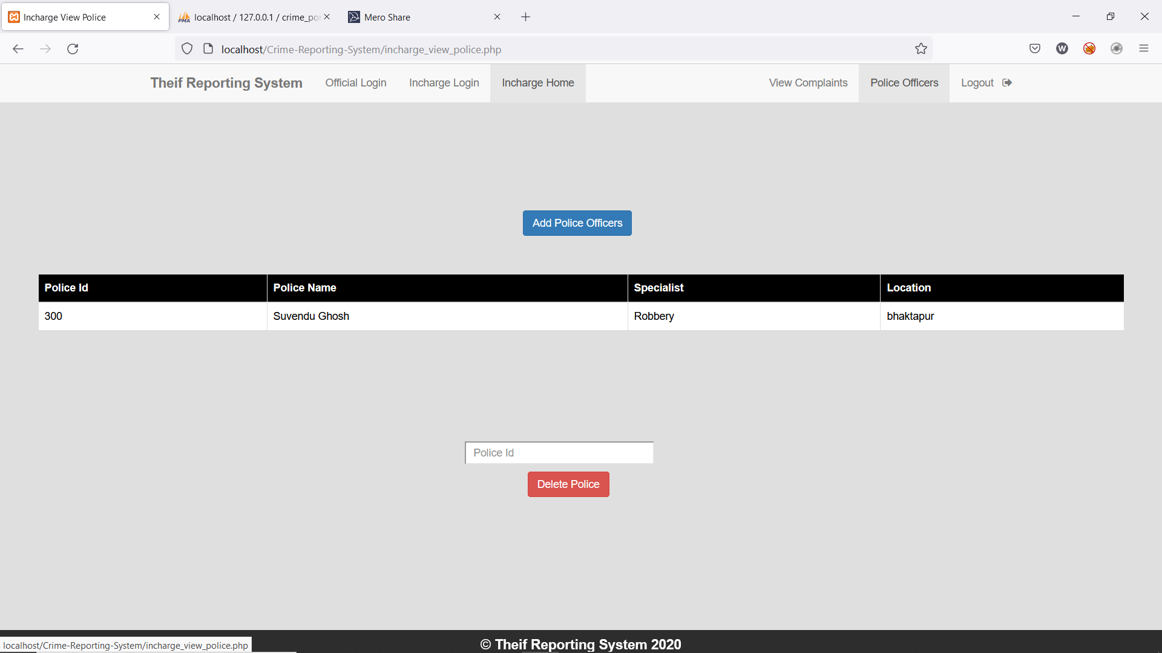
Incharge homepage

Slide 18
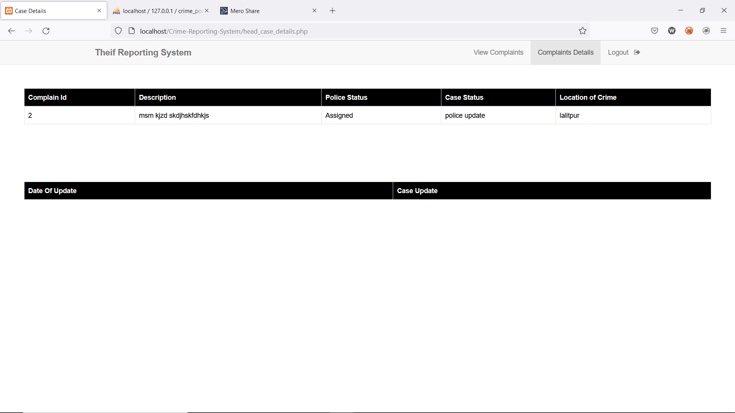
Complaint Details

Slide 19
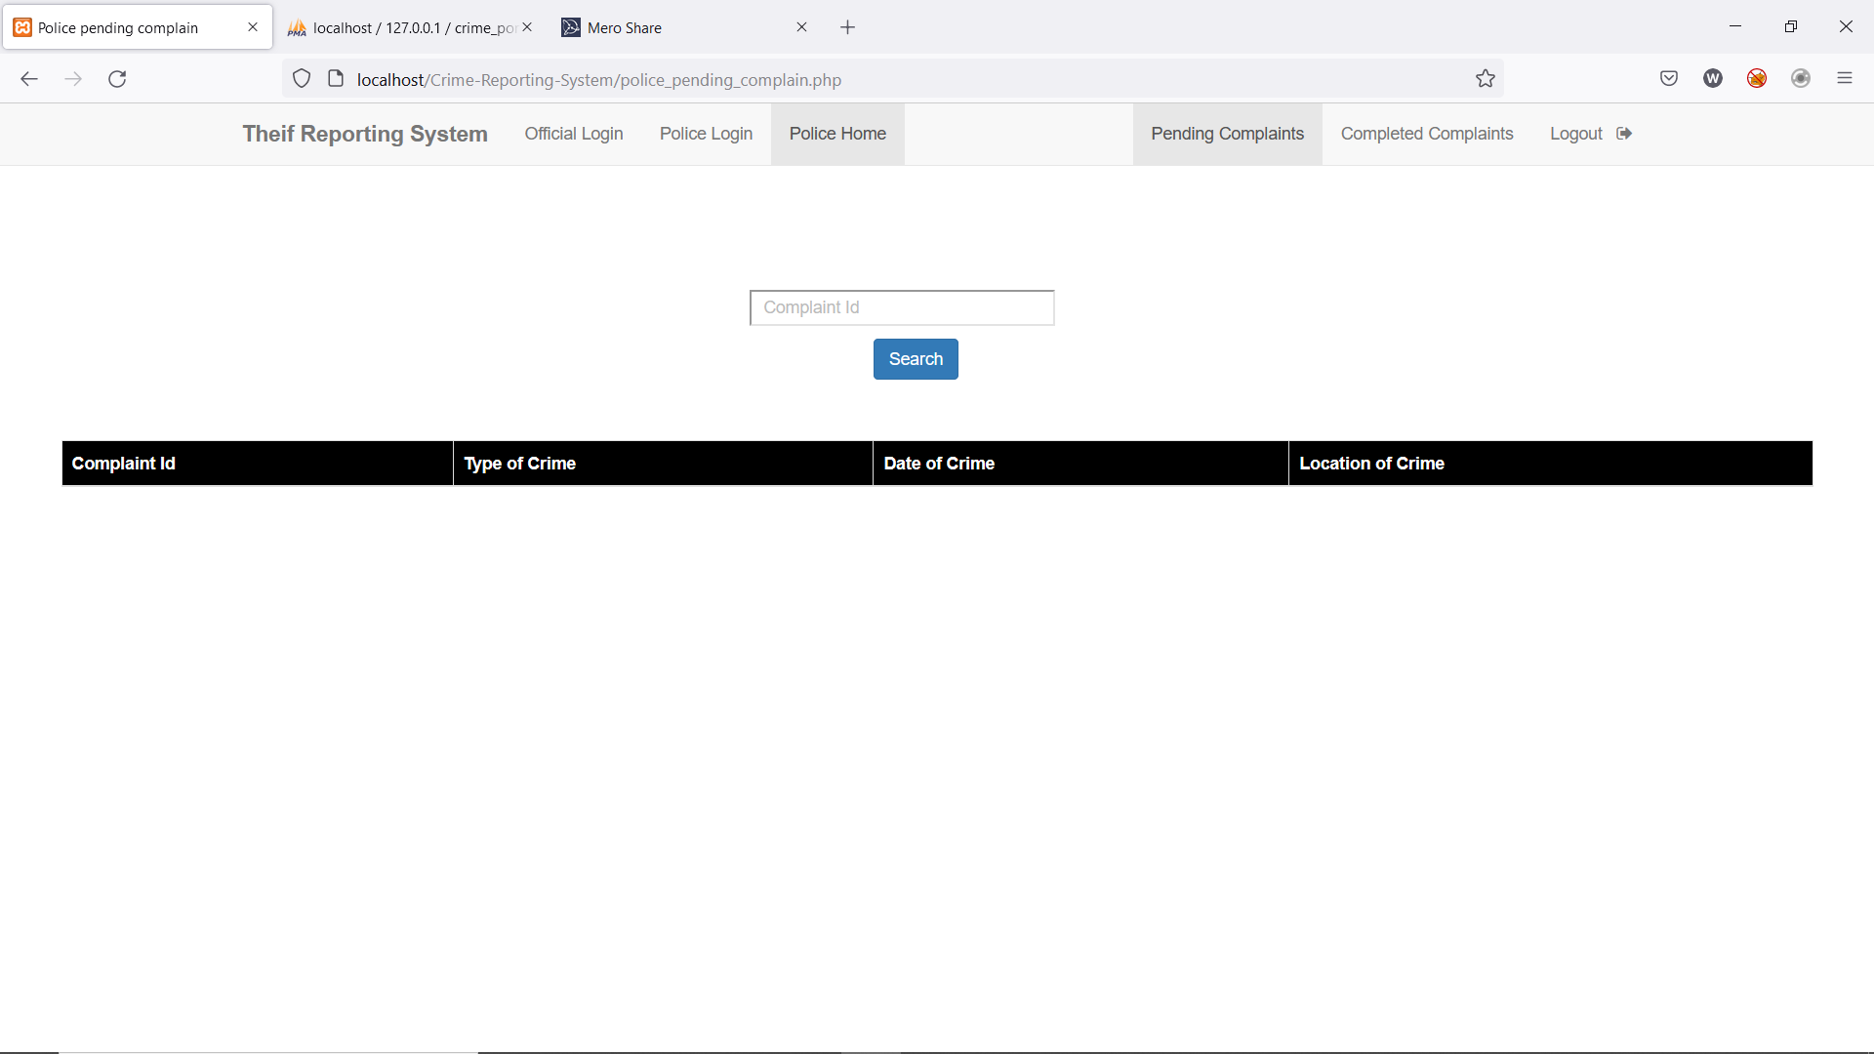
Pending Complaints

Slide 20
CONCLUSION
This project is user friendly web application which is used to increase the efficiency of police to catch thieves .
This application is useful for the people who wants to register the complaints online without going to police station.

Slide 21
FURTHER ENHANCEMENT
In the future, we can add a feature so that the system will be able to auto assign the police in a particular case as per their specialization.
We will be able to add a feature to notify the user who complained about the crime, once the case has been closed.
For security purpose after the incharge login gets activated, it will be possible to notify the incharge by the means of mail or otp.

Slide 22
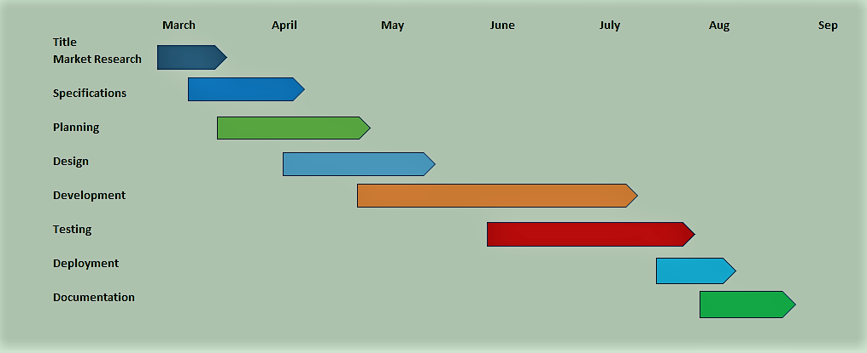
WORKING SCHEDULE

Slide 23
THANK YOU…

